Slide 1
Learning to Localize Sound Source in Visual Scenes
Arda Senocak, Tae-Hyun Oh, Junsik Kim, Ming-Hsuan Yang, In So Kweon. Senocak, Proceedings of the IEEE Conference on Computer Vision and Pattern Recognition. 2018.
Presenter :
Energy AI – Sohee Kim

Slide 2

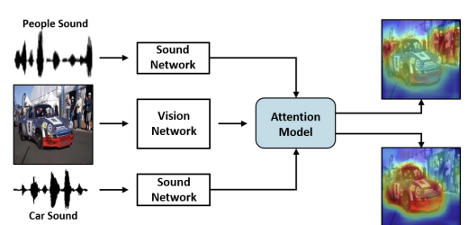
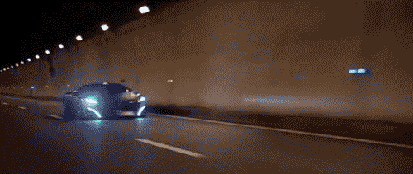

Learning to Localize Sound Source in Visual Scenes
1/25
Introduction
Learning based sound source localization
Human
Car → engine sound
How to learn to localize the sources (objects) from the sound signals
Based on simply watching and listening
Notes:
When we see that car is moving, we hear the engine sound at the same time.
As shown in example, the engine sound suggests where the source may be in the physical world.
Human unconsciously learn the correlation between visual – audio examples from their whole life. Human can understand and localize the sound source even without separate education.
In this photo, we can localize sound sources naturally, that means we know where the engine sound come from without any education.
Naturally, videos and their corresponding sounds also occur together in a synchronized way.
A motivation of this work was the question “Can a machine learning model learn to associate the sound with the visual scene to reveal the sound source location without any supervision similar to human perception?”
So, in this paper, they model the spatial correspondence between visual and audio information by leveraging the correlation between the modalities based on simply watching and listening to videos in unsupervised way, called learning based sound source localization

Slide 3
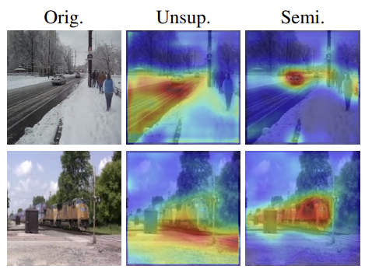
Learning to Localize Sound Source in Visual Scenes
2/25
Introduction
Learning task from unlabeled data = challenging
Unconstrained video contains
Unrelated audio
Audio source that is off the screen
Pigeon superstition
Biases the resulting localization to be unmatched
Semi-supervised setting
Provide some prior knowledge
Add supervised loss
Annotated data
Notes:
The learning task from listening is challenging, especially from unlabeled data.
Unconstrained videos are likely to contain unrelated audio to the visual contents or audio source that is off the screen, like narration, commenting, etc.
Another challenge is a classical phenomenon in learning theory, pigeon superstition.
It is an experiment about delivering food to hungry pigeons in a cage at regular time. Pigeons believe that their specific action make food arrive, reinforced to do a specific action. Such self-reinforcement occurs regardless of trueness of causality of the event and its chance.
Some of such issues that naturally occur in the context of animal learning also appear in machine learning.
These biases the resulting localization to be semantically unmatched, in some examples.
Unsupervised are difficult to disambiguate the sound sources without certain amount of supervision, as the picture show.
They correct this issue by semi-supervised setting by adding a supervised loss to network.
They annotate a new sound source localization dataset.
Their dataset is the first to address the problem of learning-based sound localization.

Slide 4
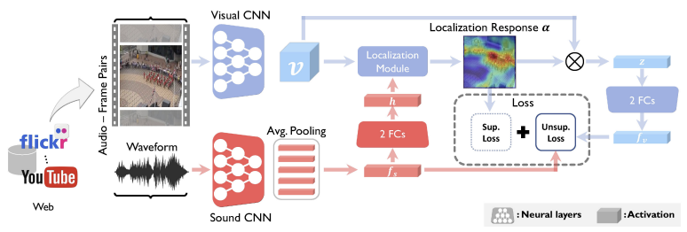
Learning to Localize Sound Source in Visual Scenes
3/25
Introduction
Network Architecture
Notes:
They designed model by using 2 stream network architecture (sound and visual network).
It is designed to tackle the problem of sound source localization with unsupervised learning.
I will explain more about architecture later.

Slide 5
Learning to Localize Sound Source in Visual Scenes
4/25
Introduction
Network Architecture
The main contributions
A learning framework to localize sound source using the attention mechanism, guided by sound information
A unified end-to-end deep convolutional neural network architecture
unsupervised, semi-supervised, fully-supervised
Collect and annotate a new sound source localization dataset
Notes:
So, The main contributions of this paper is these 3 things.
They introduced a learning framework to localize sound source using the attention mechanism, which is guided by sound information, with a paired sound and video frame.
And They proposed a unified end-to-end deep convolutional neural network architecture that accommodates unsupervised, semi-supervised, and fully-supervised learning.
Also, They collected and annotated a new sound source localization dataset, which provides supervised information and facilitates quantitative and qualitative analysis.

Slide 6
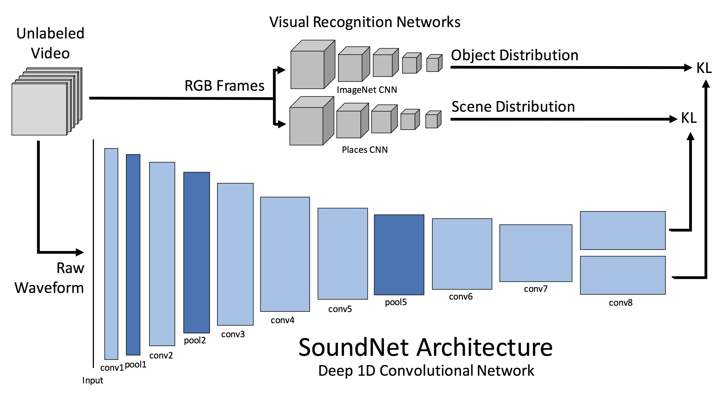
Learning to Localize Sound Source in Visual Scenes
5/25
Related Work and Problem Context
Recent work
SoundNet
Visual imagery as supervision for sound
Audio module in this work
Aytar et al. and Arandjelovic et al.
Aligned cross-modal representations
Activation maps that localize object → Not interactively estimated according to the given sound
A bridge layer
Reveals the localization information of the sound sources
Notes:
Next is about related work and problem context.
Recent methods considered sound as supervisory signal, while the soundnet regards visual imagery as supervision for sound. A network similar to this, is used as audio module in this work.
Concurrently, Other proposed to learn jointly aligned cross-modal representations. They shows the activation maps that localize object, but not interactively estimated according to the given sound.
So, in contrast, this work has a bridge layer that interacts the 2 modalities and reveals the localization information of the sound source.

Slide 7
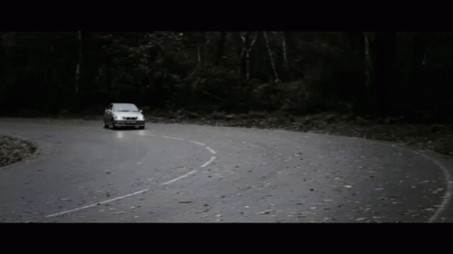

Learning to Localize Sound Source in Visual Scenes
6/25
Related Work and Problem Context
Recent work
Sound source localization capability of humans
Guided by visual information
Two sources of information are closely correlated that humans can unconsciously learn the capability.
Notes:
This work is motivated by the findings in psychology and cognitive science on sound source localization capability of humans.
Several studies show that this is guided by visual information,
and two sources of information are closely correlated that humans can unconsciously learn the capability.

Slide 8
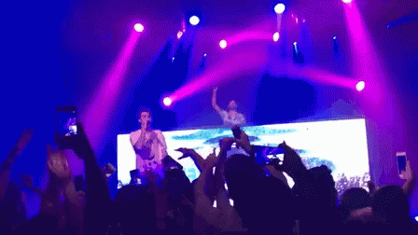
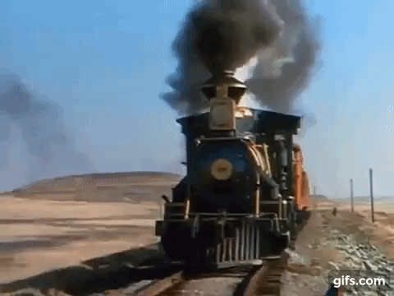
Learning to Localize Sound Source in Visual Scenes
7/25
Related Work and Problem Context
Recent work
Deep learning methods rely on
Synchrony of low-level features of sounds and videos
Spatial sparsity prior of audio-visual events
Low-dimensionality
Hand-crafted motion
An unsupervised manner by only watching and listening to videos without using any manually designed constraints such as motion.
Notes:
Prior to the recent advances of deep learning, computational methods for sound source localization rely on synchrony of low-level features of sound and videos, and so on.
In contrast, this work is developed in an unsupervised manner by only watching and listening to videos
without using any manually designed constraints such as motion.

Slide 9
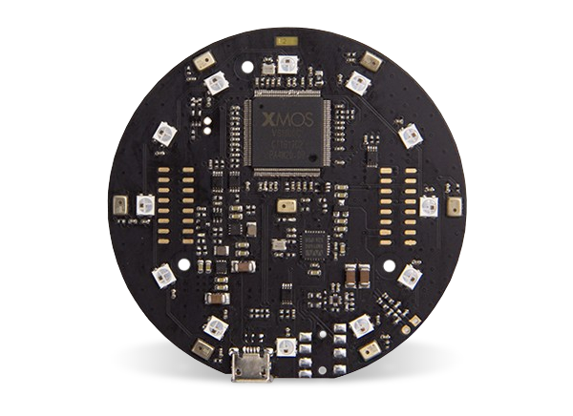

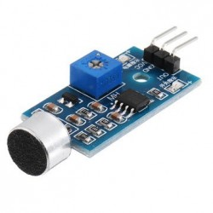
Learning to Localize Sound Source in Visual Scenes
8/25
Related Work and Problem Context
Recent work
Acoustic based approach - in surveillance and instrumentation engineering
Requires specific devices (microphone arrays)
Without any special devices but a microphone to capture sound
Notes:
Acoustic based approach has been practically used in surveillance and instrumentation engineering. It requires specific devices as microphone arrays, to capture phase differences of sound arrival.
In this work, we learn sound source localization in the visual domain without any special devices but a microphone to capture sound.

Slide 10
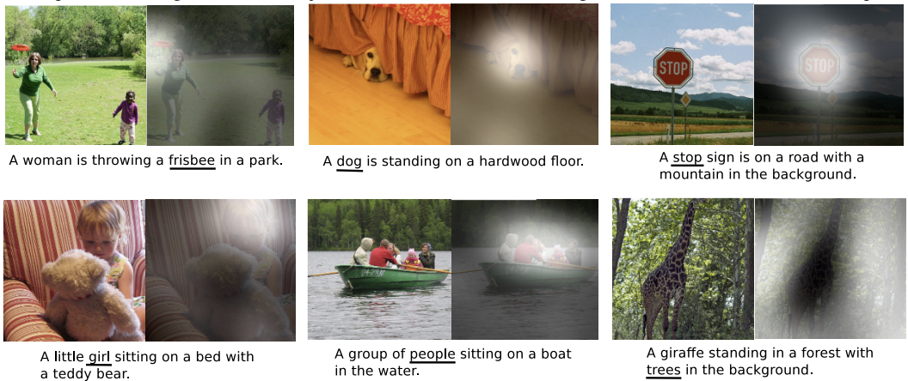
Learning to Localize Sound Source in Visual Scenes
9/25
Related Work and Problem Context
Recent work
Attention mechanism philosophy
Interact with sound context and visual representation across spatial axes
Ref) Xu, Kelvin, et al. "Show, attend and tell: Neural image caption generation with visual attention."
International conference on machine learning. PMLR, 2015.
Notes:
Inspired by human attention mechanism, computational visual attention models have been developed.
However not only visual attentions but also the sound localization behavior in imagery resemble to the human attention. In this work adopted the same attention mechanism philosophy to allow the networks to interact with sound context and visual representation across spatial axes.

Slide 11
Learning to Localize Sound Source in Visual Scenes
10/25
Proposed Algorithm
Vision based sound localization within the unsupervised learning framework
> Two-stream network architecture
Sound network
Visual network
Attention model
Notes:
They designed a neural network to address the problem of vision-based sound localization within the unsupervised learning framework.
In order to deal with cross-modality signals from sounds and videos, we use a two-stream network architecture.
The network composes of three main modules: sound network, visual network and attention model as illustrated.

Slide 12
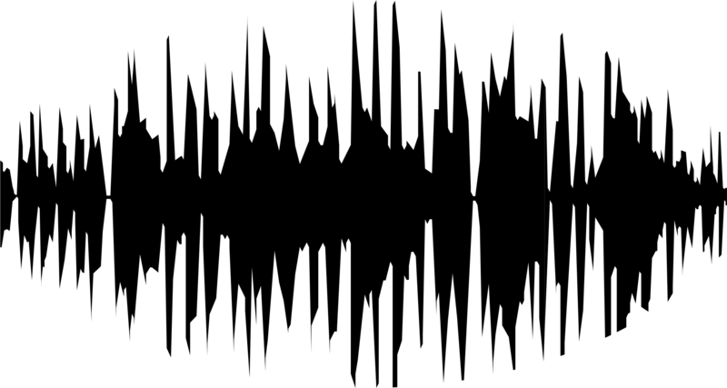
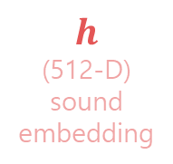
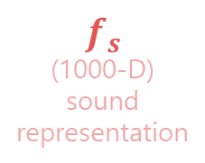
Learning to Localize Sound Source in Visual Scenes
Proposed Algorithm
Sound Network
Capture the concept of sound
Convolutional module (conv), rectified linear unit (ReLu), pooling (pool) -> stack 10 layers
1-D deep convolutional architecture : invariant to input length
Use average pooling over sliding windows
conv1 ~ conv8
SoundNet
Input
9, 10TH
Output
$$f_{s}$$
(1000-D) sound representation
ReLu-Fc
layers
$$h$$
(512-D)
sound embedding
raw waveform
+ 1000filters + Avg. Pooling
(sliding window 20sec)
11/25
Notes:
For sound localization, it is important to capture the concept of sound rather than catching low-level signal.
They represent sound signals by using the convolutional module (conv), rectified linear unit (ReLu) and pooling (pool), and stacking layers to encode high-level concepts.
They use a 1-D deep convolutional architecture which is invariant to input length as fully convolutional networks via the use of average pooling over sliding windows.
The proposed sound network consists of 10 layers and takes raw waveform as input.
The first conv layers (up to conv8) are similar to the SoundNet, but with 1000 filters followed by average pooling across the temporal axis within a sliding window ,20 seconds.
the output activation of conv8 followed by average pooling is always a single 1000-D vector by a sliding window.
The sound representation after average pooling is fs.
To encode higher level concept of the sound signals, the 9-th and 10-th layers consist of ReLU followed by fully connected (FC) layers. The output of the 10-th FC layer (FC10) is 512-D, and is denoted as h.
We use h to interact with features from the visual network and enforce h to resemble visual concepts.
Among these two features, we note fs preserves more sound concept while h captures correlation information related to visual signals.

Slide 13

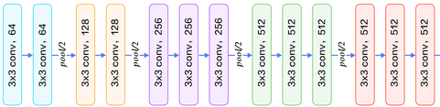
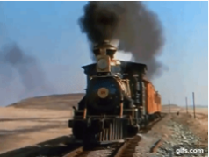
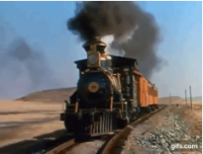
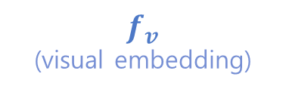
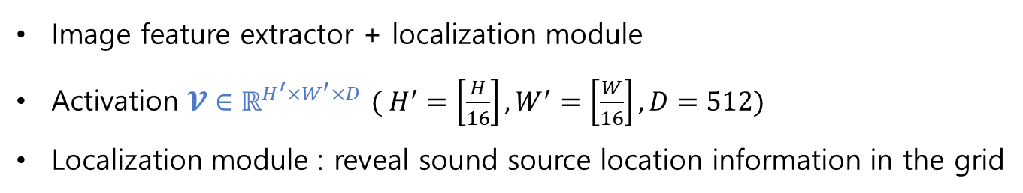
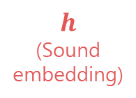
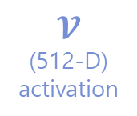

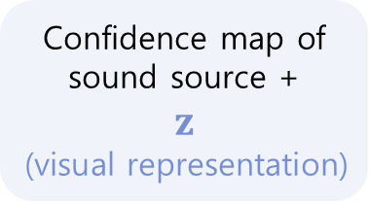
Learning to Localize Sound Source in Visual Scenes
Proposed Algorithm
Visual Network
Image feature extractor + localization module
Activation $𝓥∈ℝ^{H^{′}×W^{′}×D}$ $( H^{′}=\left[\frac{H}{16}\right],W^{′}=\left[\frac{W}{16}\right], D=512)$
Localization module : reveal sound source location information in the grid
Confidence map of sound source +
$$z$$
(visual representation)
~ conv5_3
Input
$$𝓥$$
(512-D)
activation
Localization module
$$2×$$
ReLu-Fc
Color video frames
(H x W)
VGG-16
$$h$$
(Sound embedding)
$$f_{v}$$
(visual embedding)
Output
12/25
Notes:
The visual network is composed of the image feature extractor and localization module.
To extract features from visual signals, they used an architecture similar to the VGG16 model up to conv5 3 and feed a color video frames of size H×W as input.
The activation of conv5 3 are V, a tensor representation form like this equation.
Each activation vector contains local visual context information, and spatial information is preserved in H times W grid.
We make the activation V interact with the sound embedding h for revealing sound source location information in the grid, which is denoted as the localization module.
This localization module returns a confidence map of sound source and a representative visual feature vector z.
Once we obtain the visual feature z, it goes through two {ReLu-FC} blocks to compute the visual embedding fv, which is the final output of the visual network.

Slide 14
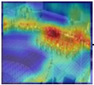
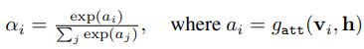
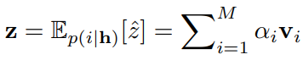
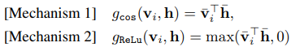

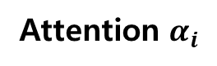
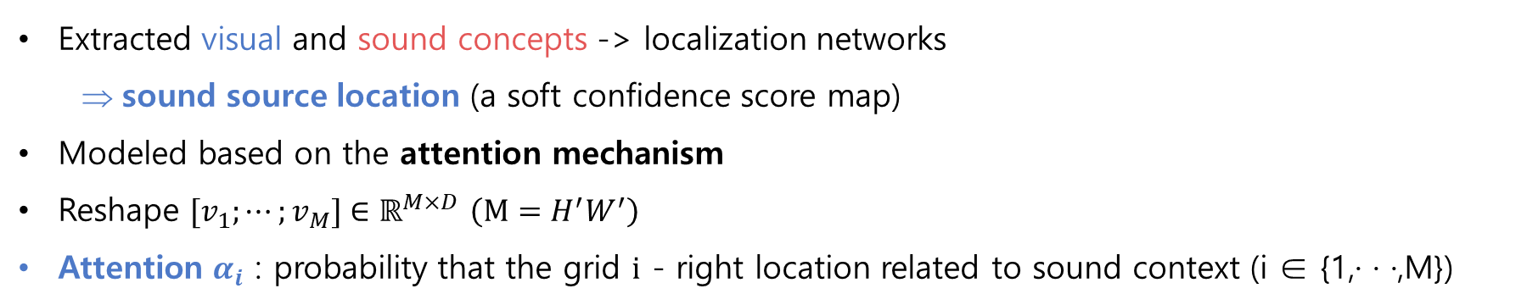
Learning to Localize Sound Source in Visual Scenes
Proposed Algorithm
Localization Network
Extracted visual and sound concepts -> localization networks
sound source location (a soft confidence score map)
Modeled based on the attention mechanism
Reshape $[v_{1};⋯;v_{M}]∈ℝ^{M×D}$ $\left(M=H^{′}W^{′}\right)$
Attention $α_{i}$ : probability that the grid $i$ - right location related to sound context (i ∈ {1,· · ·,M})
Attention $α_{i}$
Visual feature $Z$
The local visual feature at the sound source location
map
13/25
Notes:
Given extracted visual and sound concepts, the localization networks generate the sound source location.
They computed a soft confidence score map. This may be modeled based on the attention mechanism in the human visual system.
They reshaped activation v as this equation for simplicity.
For each location i , Attention mechanism g_att generates positive weight alpha_i by the interaction between the given sound embedding h and v_i, where alpha_i is the attention measure.
It can be interpreted as the probability that the grid i is likely to be the right location related to the sound context and computed by this equation.
The two-attention mechanism are proposed (where x bar denotes a l2 normalized vector).
(Both are based on cosine similarity of the range [-1,1].)
The computed attention measure alpha describes the sound and visual context interaction in a map.
To give a connection to α with sound source location, they compute the representative context vector z that corresponds to the local visual feature at the sound source location.
It is obtained by given equation.
(As described before, they transform z to a visual representation f_v. We adapt fv to be comparable with the sound features fs obtained from the sound network, such that we learn the features to share embedding space.)

Slide 15
Learning to Localize Sound Source in Visual Scenes
14/25
Localizing Sound Source via Listening
> Video frame
> Video
prediction
> Audio signals - sound
prediction
Notes:
Their learning model determines a video frame and audio signals are similar to each other or not/ at each spatial location.
With the proposed two-stream network, they obtain predictions from each subnetwork for the frame and the sound.
In this example, If the visual network considers a given frame contains a train/ and sound network also returns similar output, then the predictions of these two networks are likely to be similar and close to each other in the feature space, and vice versa.
This provides valuable information for learning to localize sound sources in different settings.

Slide 16
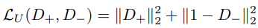
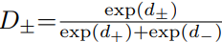
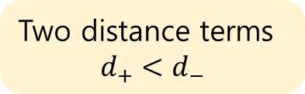
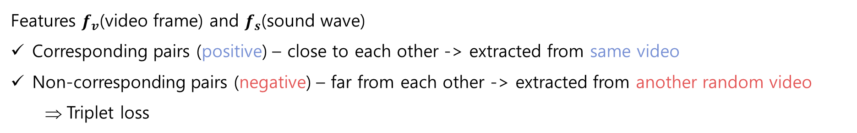
Learning to Localize Sound Source in Visual Scenes
15/25
Localizing Sound Source via Listening
Unsupervised learning
Features $f_{v}$(video frame) and $f_{s}$(sound wave)
Corresponding pairs (positive) – close to each other -> extracted from same video
Non-corresponding pairs (negative) – far from each other -> extracted from another random video
Triplet loss
> A triplet network
> Unsupervised loss function
query
Positive sample
Two distance terms
$$d_{+}<d_{−}$$
Negative sample
Notes:
For unsupervised setting, they use the features fv and fs from two networks.
In the feature space, they impose that fv and fs from the corresponding pairs (positive) are close to each other, while non-corresponding (negative) pairs are far from each other.
They use fv from a video frame as a query, and its positive pairs are obtained by taking fs from the sound wave from a sliding window around the frame of the same video,
while negative ones are extracted from another random video.
Given these positive and negative pairs, they use the triplet loss for learning.
As shown in first equation, the triplet input is composed of query, positive sample and negative sample.
The loss is designed to map the positive samples into the same location with the query in the feature space, while mapping the negative samples into distant locations.
This output 2 distance terms, d+ the positive and d- the negative.
The negative, d- should be larger than positive d+ because negative should be far from each other.
Then the unsupervised loss function is defined as that second equation.

Slide 17
Learning to Localize Sound Source in Visual Scenes
16/25
Localizing Sound Source via Listening
> A cycle loop
Notes:
For the positive pair, the unsupervised loss imposes the visual feature fv to be resembled to fs.
In order for z to generate such fv, the weight α needs to select causal locations by the correlation between h and v.
This results in h to share the embedding space with v, and fs also needs to encode the context information that correlated with video frame.
This forms a cycle loop as shown.

Slide 18
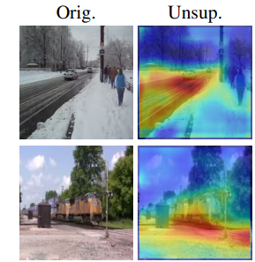
Learning to Localize Sound Source in Visual Scenes
17/25
Localizing Sound Source via Listening
Unsupervised learning - issue
The pigeon superstition issue
⇒ False conclusion
Road > Car
Difficult without supervisory feedbacks
Biasing toward a certain semantically unrelated output
> Railways rather than train
Notes:
Although this unsupervised learning method performs well, they encountered the pigeon superstition issue as discussed before.
For example, as shown in picture, even though they present a train sound with a train image, the proposed model localizes railways rather than the train.
This is a false conclusion by the model that causes some semantically unmatched results.
It can be explained as follows.
In the early stage, the model mistakenly concludes with false random output. However, it obtains a good score (as it is paired), thereby the model is trained to behave similarly for such scenes. It again reinforces its model to receive good scores in similar examples.
For example, in the case of road, the proposed network consistently sees road with similar car sound during training.
Since road has simpler appearance and typically occupies larger regions compared to diverse appearance of the car,
it is difficult for the model to discover the true causality relationship with the car without supervisory feedbacks.
This ends up biasing toward a certain semantically unrelated output, as in pigeon superstition problem.

Slide 19
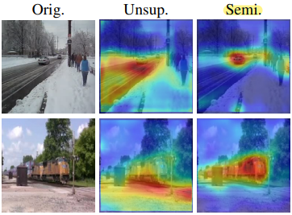
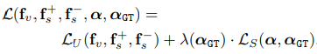
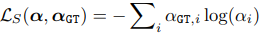
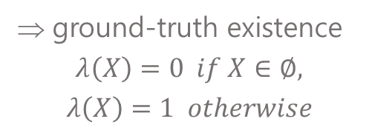
Learning to Localize Sound Source in Visual Scenes
18/25
Localizing Sound Source via Listening
Semi-supervised learning
A small amount of prior knowledge – induce better inductive bias
Add a supervised loss
> Semi-supervised loss function
Ground-truth attention map
> Cross entropy loss
Supervised loss
Unsupervised loss
Function
for controlling the data supervision type
ground-truth existence
$$λ\left(X\right)=0 if X∈∅,$$
$$λ\left(X\right)=1 otherwise$$
Notes:
As a solution of the issue, they proposed semi-supervised learning method.
Even a small amount of prior knowledge may induce better inductive bias.
They add a supervised loss into the proposed network architecture under the semi-supervised learning setting.
This is the formula of semi-supervision loss.
LU denote unsupervised losses, and Ls denote supervised losses.
α_GT denotes the ground-truth attention map, and λ(·) is a function for controlling the data supervision type.
It will be 1 when ground-truth data exist.
The supervised loss LS can be the mean square error or cross entropy loss. And the cross entropy loss performs slightly better. So they adopted cross entropy loss.
With this formulation, we can easily adopt the loss to be either supervised or unsupervised one according to the existence of ground-truth for each sample.
And this can be directly utilized for the fully supervised training.

Slide 20
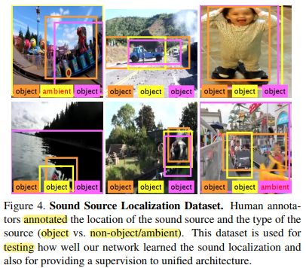
Learning to Localize Sound Source in Visual Scenes
19/25
Experimental Results
Dataset
> Annotated
Unlabeled Flickr-SoundNet dataset
more than 2 million unconstrained sound & image pairs
Random subset of 144k pairs - train
Annotated in image coordinates
Training supervision models
5k frames + sound → 3 subjects
Listen 20 secs
Draw bounding box
Tag the bounding box as object or ambient
2786 pairs => 250 – Testing, 2236 – Training
Notes:
And next is the Experimental Results.
For evaluation, they first construct a new sound source localization dataset, but the semantically unmatched localized results has been observed when in a unsupervised way. In experiment, to demonstrate if this issue can be corrected with a few supervision, they compared their unified network in unsupervised, semi-supervised, and supervised learning schemes.
They used unlabeled Flickr-soundnet dataset, which consists of more than two million unconstrained sound and image pairs.
They used a random subset of 144k pairs to train network.
For benchmark purpose, they collected a new dataset that source of sounds are annotated in image coordinates using pairs from the Flickr-SoundNet set.
This dataset provides annotations for training supervision models.
They randomly sample 5k frames and its corresponding sound from Flickr-SoundNet dataset.
They made three subjects annotate sound source location as seen in the picture, by these instructions.
First, listen 20sec and draw bounding box on the frame at the regions where the sound would come from.
Then, tag the bounding box as object or ambient.
Since the dataset contains unconstrained videos, some frames do not have the sound source in the frame / or sound source cannot be represented by drawing a box like wind sound.
To distinguish this, the tag is separated to “object” or “ambient/not object”. After annotation process, ambient pairs are filtered out.
And the one which subjects agree that sound indicating objects present in the frame is selected from the remaining object pairs.

Slide 21
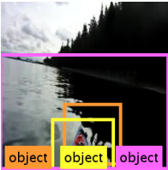
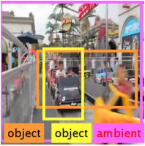
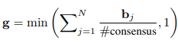
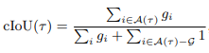
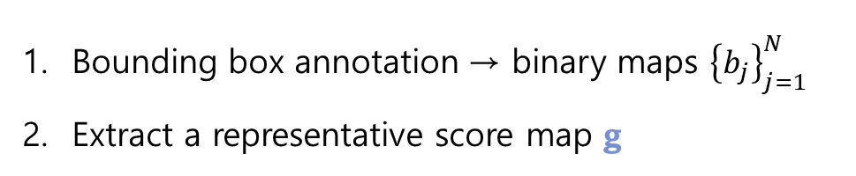
Learning to Localize Sound Source in Visual Scenes
20/25
Experimental Results – results and analysis
Evaluation metrics
3 annotations from 3 respective subjects
Weighted score map
Bounding box annotation → binary maps ${\left\{b_{j}\right\}}_{j=1}^{N}$
Extract a representative score map g
N = 3
Min. opinion to agreement = 2
> ambiguous
Positives ≥ #consensus → g = 1
Consensus intersection over union (cIoU)
Notes:
We have three annotations from three respective subjects for each data.
As some could be ambiguous like these pictures, they presented a consensus metric, cIoU, to take issue of multiple annotations into account.
They assigned scores to each pixel.
First, they convert the bounding box annotation to binary maps b_j. N is the subject number so it is 3 here.
Then they extracted a representative score map g by this equation, that #hash consensus means the minimum number of opinion to reach agreement which is 2 here.
For example, for a pixel, when positives are more than 2, the pixel of g is set to 1, a full score.
Given this weighted score map g and predicted location response alpha, cIoU is defined as this.

Slide 22
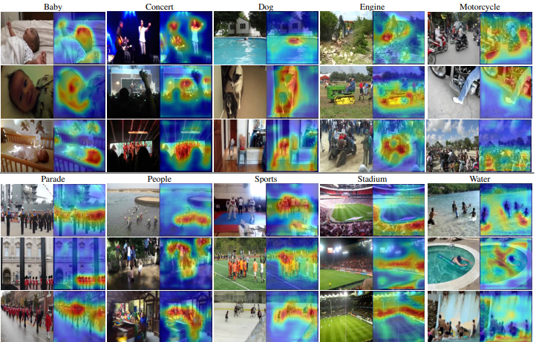
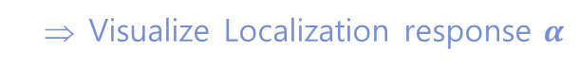
Learning to Localize Sound Source in Visual Scenes
21/25
Experimental Results – results and analysis
Qualitative Analysis
Visualize Localization response $α$
Unsupervised Network
Notes:
In qualitative comparisons, they mainly visualize the localization response α.
This is the localization results of the image-sound pairs using unsupervised learning approach.
It is interesting that sound sources are successfully localized in spite of clutters, and unrelated areas are isolated.
Seeing the water column, people are isolated from the highlighted water areas. And as seen in concert column, the model distinguish people on the stage from the audiences.

Slide 23
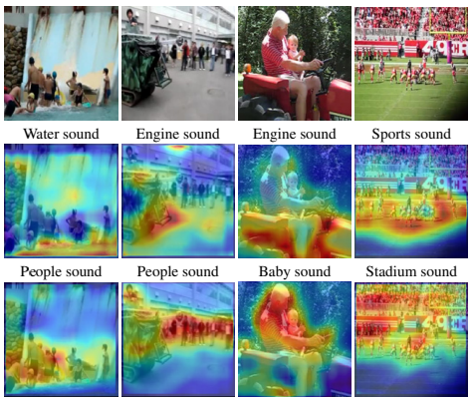
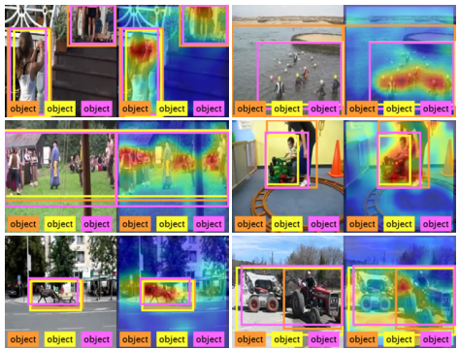
Learning to Localize Sound Source in Visual Scenes
22/25
Experimental Results – results and analysis
Qualitative Analysis
> Interactive sound source localization
> Our Network vs Human annotation
Notes:
First figure shows examples of different input sounds for same images /where the localization responses change /according to the given sound context.
For the frame that contains water and people, when water sound is given the water area is highlighted. It is same to people sound.
Second figure compares the localization performance of learned model with respect to human annotation.

Slide 24
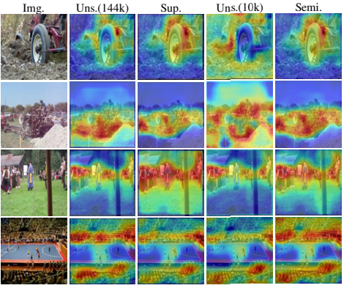
Learning to Localize Sound Source in Visual Scenes
23/25
Experimental Results – results and analysis
Qualitative Analysis
Different Learning Methods
Notes:
This is sound localization results from different learning methods. The supervised method generally localizes the sound source precisely due to the guidance of ground truths. Despite using less supervised data, the semi-supervised approach also gives comparably accurate localization results.

Slide 25
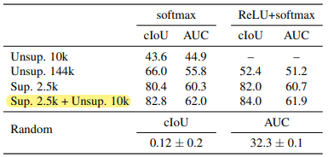
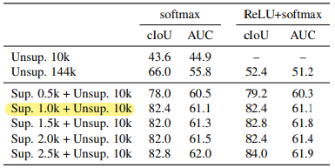


Learning to Localize Sound Source in Visual Scenes
24/25
Experimental Results – results and analysis
Quantitative Analysis
Table 1
Table 2
Semi-supervised learning with different number of samples
Table 3
Performance measure against individual subjects
Performance evaluation with different learning schemes
Notes:
In quantitative comparisons,
Table 1 shows the evaluation results using different learning schemes and number of samples.
The semi-supervised model achieved the best performance. The results suggest there is complementary information from unlabeled data, which facilitates the model generalize well.
The plot of success rate of the test samples is shown below.
In Table 2, They measured the effect of the number of labeled samples in the semi-supervised scenario.
The results show that near 1 thousand supervised samples are sufficient for the semi-supervised model to learn well.
In Table 3 shows the IoU performance of each annotator. Despite the ambiguity nature of the localization task, the results show that human perception of sound localization in images is consistent.

Slide 26

Learning to Localize Sound Source in Visual Scenes
25/25
Discussion and Conclusion
Learning based sound source localization in visual scenes – build its new benchmark dataset
The model plausibly works / can often get to false conclusion without prior knowledge.
Leveraging small amount of human knowledge can correct to capture semantically meaningful relationships
The task is not fully learnable problem only with unsupervised data, but it can be fixed by providing even small amount of supervision.
To deduce the way of machine learning about sound source localization in visual scenes.
Sound based representation learning : at least small amount of supervision should be incorporated
Open many potential directions for future research
Multi-modal retrieval
Sound based saliency or representation learning and its applications.
Pigeons issue
Ref) R. Arandjelovic and A. Zisserman. Look, listen and learn. In ´ IEEE International Conference on Computer Vision, 2017
Notes:
In conclusion,
They tackled a new problem, learning based sound source localization in visual scenes, and build its new benchmark dataset.
The model plausibly works in a variety of categories but partially, in that the network can often get to false conclusion without prior knowledge.
Also shown that leveraging small amount of human knowledge can discipline the model, so that it can correct to capture semantically meaningful relationships.
These may imply that, the task is not fully learnable problem only with unsupervised data, but it can be fixed by providing even small amount of supervision.
The results and conclusion may allow to deduce the way of machine understanding about sound source localization in visual scenes.
As a likely case, the results may indicate that some of representations behave like the pigeons (as in the second-row picture)/ and suggest that at least small amount of supervision should be incorporated for sound-based representation learning.
Additionally, this work would open many potential directions for future research,
Like multi-modal retrieval, sound-based saliency or representation learning and its applications.

